Slide 1
InsightEats Case Study
By: Gabriel Chan
Oct 30, 2025

Slide 2
Agenda
Problem Statement
Architecture Design
Data Discovery
Data Modeling
Pipeline Example
DAG Workflow
Configurable & Modular Pipeline Design
AI Integration
Failure Scenario
Re-visit Architecture Design

Slide 3
Problem Statement
Current Situation
InsightEats currently do not have stable data pipelines needed for traditional Business Intelligence(BI) analytics or future Artificial Intelligence (AI) use cases. There are 3 critical data sources that need to be onboarded which are QuickBite, MealDash and FoodNow.
Assumptions
There is currently no data architecture for insights and analysts are going directly to sources to infer BI analytics.
The insights on data sources are only what is provided:
QuickBite – REST API with JSON payloads (orders, deliveries, customer actions in near real-time; frequent menu updates)
MealDash – Daily CSV + YAML files via SFTP (revenue, transactions, customer feedback, menu data)
FoodNow – Kafka event streams + XML partner reports (driver statuses, delivery tracking, promotions)
Data sources need to be ingested based on refresh rates
Solution
Data Exploration and Discovery needed to incorporate into stable data pipelines needed to drive BI and build towards AI usecases.

Slide 4
Architecture Design

Slide 5
2. Data Exploration & Discovery - Contract/Template
Field | Description | Example
Data Source Name | Name of the partner or system providing the data | QuickBite
Data Owner | Contact person or team responsible for data accuracy | data-team@quickbite.com
Contract Version | Version number for the data contract | v1.2
Effective Date | When this contract takes effect – useful for when this needs to update or if contract is outdated | 2025-10-26
Data Refresh Frequency | How often data is delivered | Near real-time / Daily / Hourly
Delivery Method | How the data is provided | REST API, SFTP, Kafka, Pub/Sub, etc.
Connection Information | API key, OAuth, SSH key, usename/password | OAuth 2.0
Data Schema | Used for validations/monitoring of data | { orderNumber : int orderName: string }

Slide 6
2. Data Exploration & Discovery - QuickBite
Contract Field | Data Source Information
Data Source Name | QuickBite
Data Owner | QuickBite API contact@gmail.com
Contract Version | V1.0
Effective Date | Oct 30,2025
Data Refresh Frequency | Near real-time
Delivery Method | Rest API with Json payloads
Connection Information | API key/token
Data Schema | Will not go further for case study
Notes:
This should be in a json/yaml format to use to validate against when doing pipeline integration and monitoring

Slide 7
2. Data Exploration & Discovery - FoodNow
Contract Field | Data Source Information
Data Source Name | FoodNow
Data Owner | FoodNow_kafka contact@gmail.com
Contract Version | V1.0
Effective Date | Oct 30,2025
Data Refresh Frequency | Kafka event stream ( even based)
Delivery Method | Kafka
Connection Information | Kafka servers with SSL/TLS keys
Data Schema | Will not go further for case study
Notes:
This should be in a json/yaml format to use to validate against when doing pipeline integration and monitoring

Slide 8
2. Data Exploration & Discovery - MealDash
Contract Field | Data Source Information
Data Source Name | Meal Dash
Data Owner | Mealdash_csv@gmail.com
Contract Version | V1.0
Effective Date | Oct 30,2025
Data Refresh Frequency | Daily
Delivery Method | CSV + YAML files
Connection Information | SFTP passwordless or username/password auth
Data Schema | Next slide
Notes:
This should be in a json/yaml format to use to validate against when doing pipeline integration and monitoring

Slide 9
2. Data Exploration & Discovery - MealDash - Cont
{
"data_source_name": "MealDash",
"data_owner": "mealdash_csv@gmail.com",
"contract_version": "v1.0",
"effective_date": "2025-10-30",
"data_refresh_frequency": "daily",
"delivery_method": "CSV + YAML files",
"connection_information": {
"protocol": "SFTP",
"authentication_methods": "passwordless", "username_password"],
"notes": "Preferred method: SSH key-based (passwordless)."
},
"data_schema_reference": "mealdash_schema_v1.json",
"description": "Daily delivery of MealDash order, revenue, feedback, and menu data to InsightEats. Delivered via secure SFTP as CSV and YAML metadata files."
}
Notes:
This should be in a json/yaml format to use to validate against when doing pipeline integration and monitoring

Slide 10
2. Data Exploration & Discovery - MealDash – Data Schema
{
"orders": [
{ "name": "order_id", "datatype": "bigint", "required": true },
{ "name": "menu_id", "datatype": "bigint", "required": true },
{ "name": "revenue_id", "datatype": "bigint", "required": true },
{ "name": "quantity", "datatype": "integer", "required": true },
{ "name": "price", "datatype": "double", "required": true },
{ "name": "promotion_id", "datatype": "bigint", "required": false }
]
}
Notes:
This should be in a json/yaml format to use to validate against when doing pipeline integration and monitoring

Slide 11
4. Data Modelling
QuickBite
Orders, deliveries, customer actions, frequent menu updates
MealDash
Revenue, transactions, customer feedback, menu data
FoodNow
Driver statuses, delivery tracking, promotions
Assumption: All courier platforms need to have some sort of customer information, transaction/revenue information, menu information, delivery tracking, restaurant and promotions to function.

Slide 12
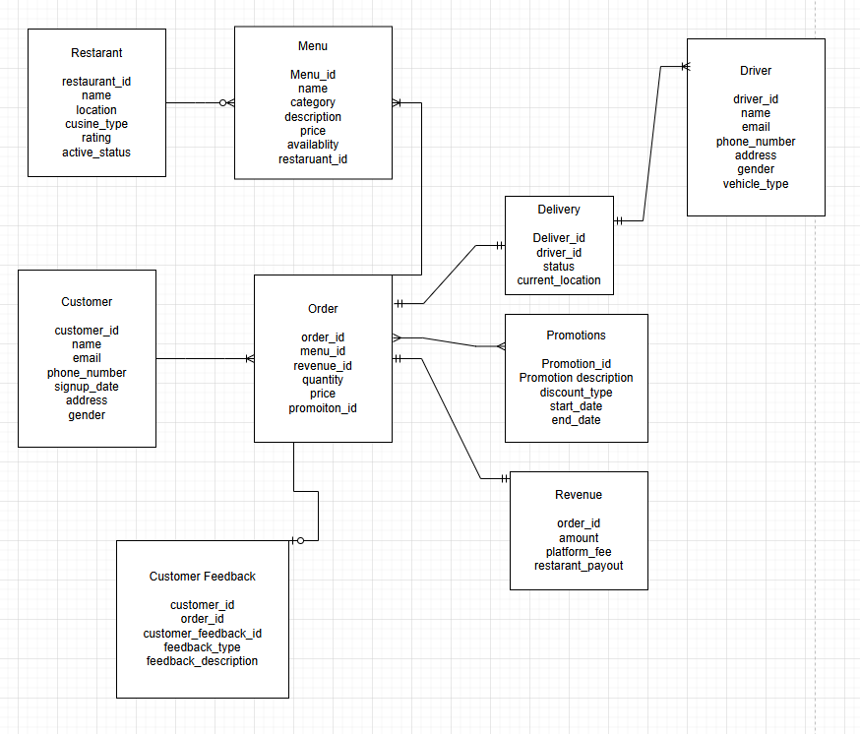
4. Data Modelling - Tables
Notes:
Task more towards orders and menus

Slide 13
Order Table
Table: Order
Name | Datatype | Description
order_id | STRING / UUID | Unique identifier for each order.
menu_id | STRING / UUID | Identifier referencing the menu item associated with the order.
revenue_id | STRING / UUID | Foreign key linking to the corresponding revenue record.
quantity | INTEGER | Number of units of the menu item ordered.
price | DECIMAL(10,2) | Price per unit of the menu item at the time of order.
promotion_id | STRING / UUID | Identifier referencing any promotion applied to the order.

Slide 14
Menu Table
Name | Datatype | Description
menu_id | STRING / UUID | Unique identifier for each menu item.
name | STRING | Name of the menu item.
category | STRING | Category of the menu item (e.g., appetizer, main course, beverage).
description | STRING / TEXT | Detailed description of the menu item.
price | DECIMAL(10,2) | Price of the menu item.
availability | BOOLEAN | Indicates whether the menu item is currently available.
restaurant_id | STRING / UUID | Identifier referencing the restaurant offering the item.

Slide 15
Revenue Table
Name | Datatype | Description
order_id | STRING / UUID | Unique identifier referencing the associated order.
amount | DECIMAL(10,2) | Total revenue generated from the order before fees.
platform_fee | DECIMAL(10,2) | Fee charged by the delivery platform for processing the order.
restaurant_payout | DECIMAL(10,2) | Net amount paid to the restaurant after deducting platform fees.

Slide 16
Delivery Table
Name | Datatype | Description
delivery_id | STRING / UUID | Unique identifier for each delivery.
driver_id | STRING / UUID | Identifier for the driver assigned to the delivery.
status | STRING | Current status of the delivery (e.g., pending, in_transit, delivered).
current_location | STRING / JSON | Real-time location of the driver or delivery, typically in coordinates.

Slide 17
Data Ingestion
Broken by data source types, for each type there should be a separate system.
REST API (JSON Format input)
Flat files (CSV or YAML)
Kafka
Handling schema drift can be handled through the data contracts on data schemas and enforcing strict typing only when standardizing
Json, csv and yaml files can be ingested to data lakes/Amazon s3 buckets as an initial phase then use AWS glue data catalog for scanning
Notes:
Can use aws glue dynamicframe method

Slide 18
Data Ingestion - Flat files (CSV or YAML)
Criteria for choosing ingestion pipeline technology
Cost
Reliability
Scalability

Slide 19
Data Ingestion - Flat files (CSV or YAML)
Criteria for choosing ingestion pipeline technology
Cost
Reliability
Scalability

Slide 20
Data Ingestion - Flat files (CSV or YAML)
Criteria for choosing ingestion pipeline technology
Cost
Reliability
Scalability

Slide 21
Data Ingestion - Flat files (CSV or YAML)
Criteria for choosing ingestion pipeline technology
Cost
Reliability
Scalability

Slide 22
Data Ingestion pseudocode for CSV
Using configurable yaml files with Amazon redshift sql queries to transform from raw to standardization
Imposing proper datatypes
Having true nulls
Trimming whitespaces
Using DAGS to call on ingestion pipelines and sql pipelines passing on parameters

Slide 23
DAG workflow – ingestion to insights
Trigger daily to standardize to curated

Slide 24
Further Insights Needed
What is the quantity that we need to ingest per load averagely
Can be added to data contract
What are the actual fields present within each data source and do we need them all
Is historical data needed?
What is the retention time for the data? (for this case study assuming 2 years max)
What is the true purpose for monitoring revenue, performance and customer actions? ( for case study assuming its for time to insight for quicker and more efficient business decisions, example: what is the business’ core customer base demographic, which promotion is most used by customers)

Slide 25
Data Exploration & Discovery - MealDash – Data Schema
{
"schema_version": "v1.0",
"data_source": "MealDash",
"description": "Schema definitions for MealDash daily data feeds: revenue, transactions, customer feedback, and menu.",
"datasets": {
"revenue": {
"description": "Daily aggregated revenue data per store and region.",
"columns": [
{ "name": "store_id", "type": "string", "required": true },
{ "name": "region", "type": "string", "required": false },
{ "name": "total_orders", "type": "integer", "required": true },
{ "name": "total_revenue", "type": "float", "required": true },
{ "name": "delivery_fees", "type": "float", "required": false },
{ "name": "promotions_applied", "type": "float", "required": false },
{ "name": "report_date", "type": "date", "required": true }
]
},
"transactions": {
"description": "Detailed transaction-level data for orders.",
"columns": [
{ "name": "order_id", "type": "string", "required": true },
{ "name": "customer_id", "type": "string", "required": true },
{ "name": "store_id", "type": "string", "required": true },
{ "name": "order_datetime", "type": "datetime", "required": true },
{ "name": "payment_method", "type": "string", "required": false, "allowed_values": ["CREDIT_CARD", "APPLE_PAY", "CASH", "OTHER"] },
{ "name": "order_total", "type": "float", "required": true },
{ "name": "delivery_fee", "type": "float", "required": false },
{ "name": "discount_amount", "type": "float", "required": false },
{ "name": "order_status", "type": "string", "required": true, "allowed_values": ["PLACED", "DELIVERED", "CANCELLED", "REFUNDED"] },
{ "name": "item_id", "type": "string", "required": true },
{ "name": "item_name", "type": "string", "required": true },
{ "name": "quantity", "type": "integer", "required": true },
{ "name": "unit_price", "type": "float", "required": true },
{ "name": "category", "type": "string", "required": false }
]
},
"customer_feedback": {
"description": "Customer ratings and feedback per order.",
"columns": [
{ "name": "feedback_id", "type": "string", "required": true },
{ "name": "order_id", "type": "string", "required": true },
{ "name": "customer_id", "type": "string", "required": false },
{ "name": "rating", "type": "integer", "required": true, "min_value": 1, "max_value": 5 },
{ "name": "comments", "type": "string", "required": false },
{ "name": "feedback_timestamp", "type": "datetime", "required": true }
]
},
"menu": {
"description": "Menu item details per store.",
"columns": [
{ "name": "menu_id", "type": "string", "required": true },
{ "name": "store_id", "type": "string", "required": true },
{ "name": "item_name", "type": "string", "required": true },
{ "name": "category", "type": "string", "required": true, "allowed_values": ["Mains", "Sides", "Appetizers", "Desserts", "Beverages"] },
{ "name": "price", "type": "float", "required": true },
{ "name": "is_available", "type": "boolean", "required": true },
{ "name": "last_updated", "type": "datetime", "required": true }
]
}
}
}
Notes:
This should be in a json/yaml format to use to validate against when doing pipeline integration and monitoring

